Slide 1
Job Conncet
This project is proudly developed by:
Gowtham K - Team Representative
Suthani K
Akhil S T

Slide 2
Introduction:
The Job Portal is a web-based platform designed to streamline the job application process for both employers and job seekers. Built using Angular for the frontend, Node.js (with TypeScript) for the backend, and MySQL for the database, this application allows employers to post job listings and manage applications easily. Job seekers can browse available job opportunities, apply for jobs directly without needing authentication, and track their submissions.

Slide 3
Problem Statement:
Job portal website - Employers to post job listings and applicants to apply without the need for authentication. Employers can manage their job posts, while applicants can browse and apply to available opportunities.

Slide 4
Objectives:
To develop a full-stack, web-based job portal for job seekers and employers.
To enable employers to post, edit, and manage job listings effortlessly.
To provide applicants with the ability to browse and apply for jobs without requiring authentication.
To create a simple, user-friendly interface using Angular, Node.js (TypeScript), and MySQL.
To streamline the job application process and make it more accessible for users.

Slide 5
Module Descriptions:
User Module (Job Seeker)
Browse Job Listings: Job seekers can view a list of all available job openings.
View Job Details: Each job listing can be clicked to reveal more detailed information, including the job description, salary range, and application deadline.
Apply for Jobs: Job seekers can apply directly for any listed job by filling out an application form with their personal details (e.g., name, email).
View Application Status: Applicants can view the status of their submitted applications to track progress.

Slide 6

Home page:

Slide 7
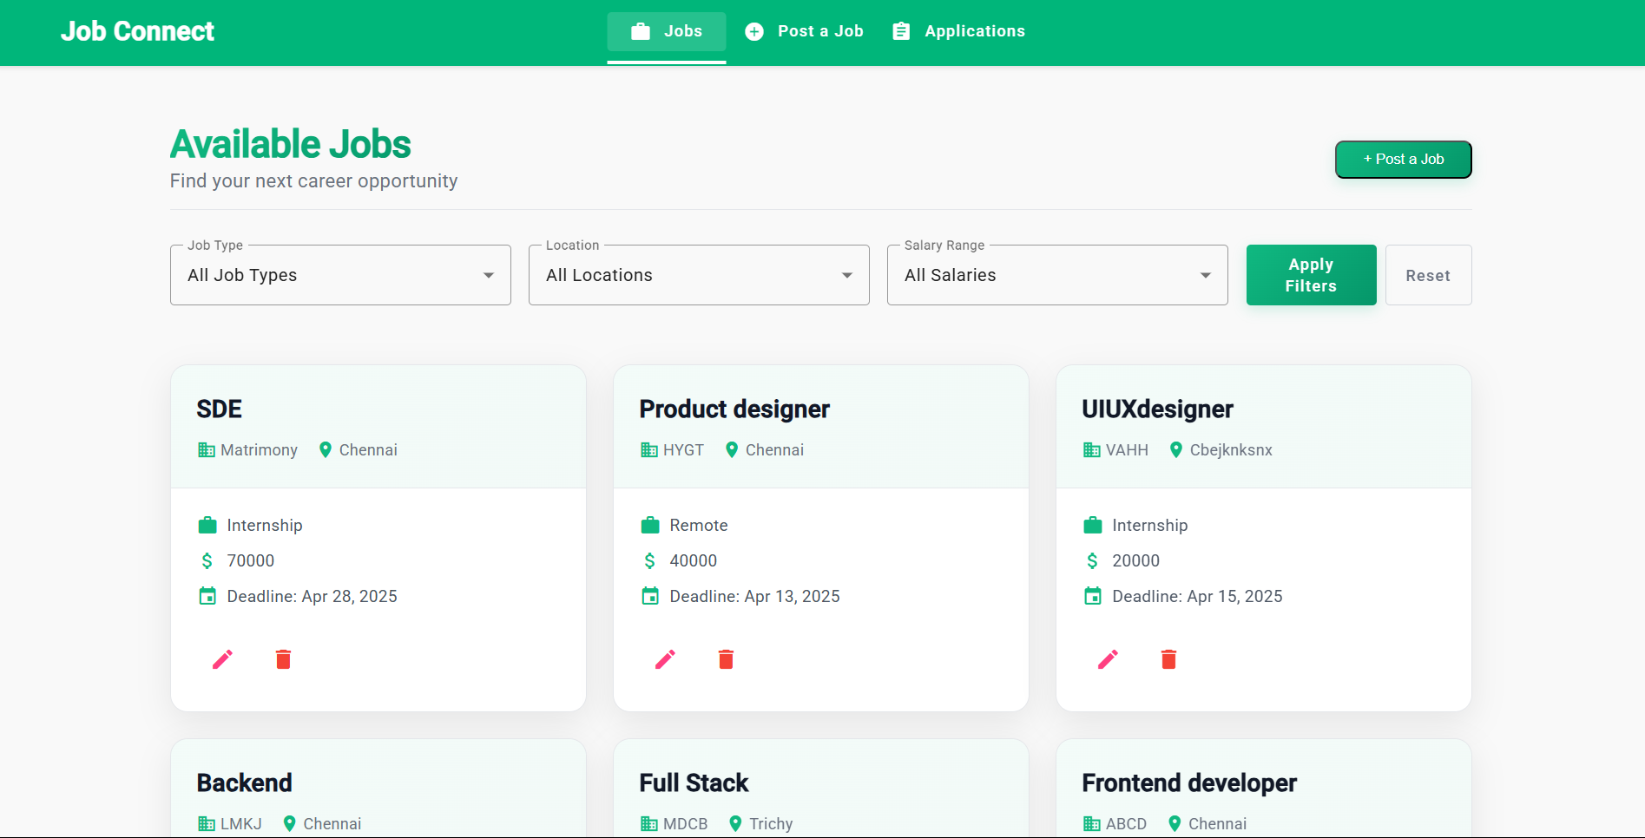
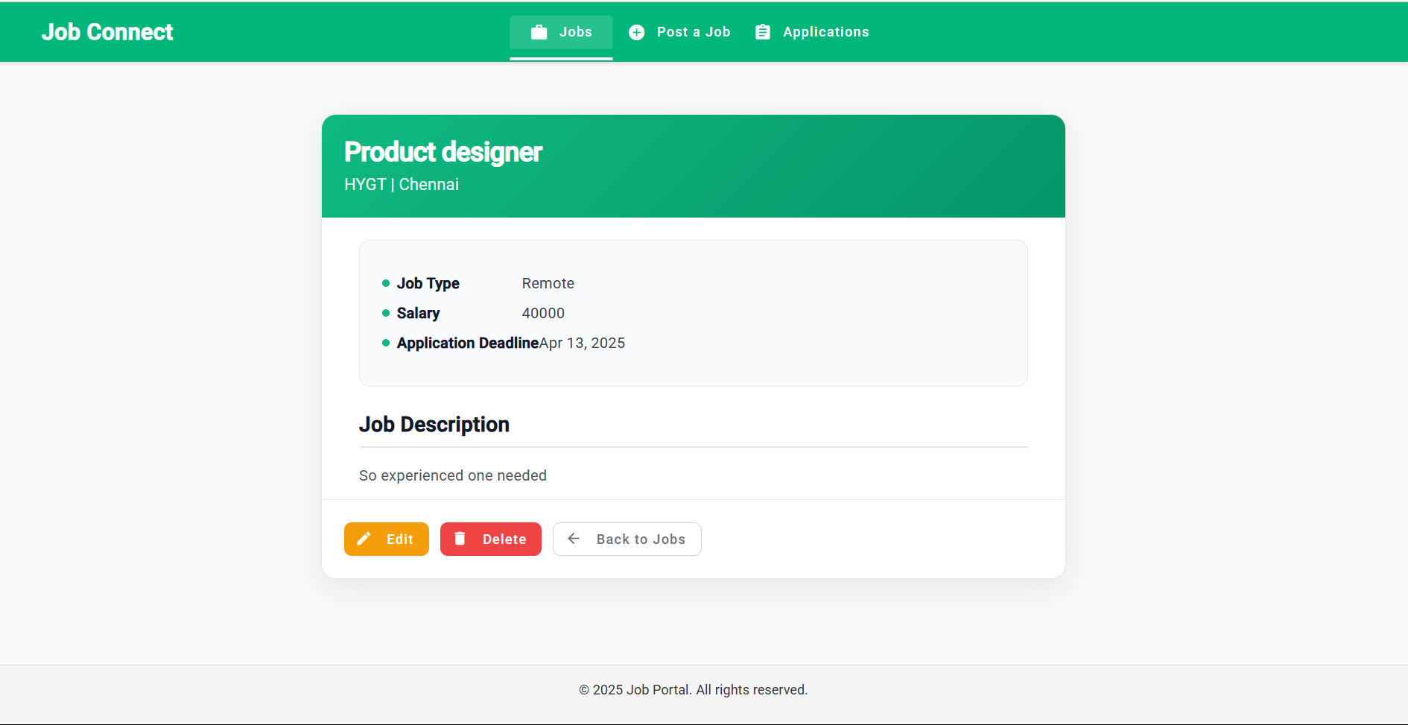
Available jobs:
Job description:

Slide 8
Employer Module
Post Job Listings: Employers can create new job postings by providing job details such as title, description, location, salary range, and application deadline.
Edit Job Listings: Employers can modify existing job listings to update information or change the job status.
Delete Job Listings: Employers have the ability to remove job postings that are no longer relevant.
View Applications: Employers can view a list of applications received for each job listing, including applicant details and submission date.
Manage Job Posts: Employers can keep track of their active job postings and the status of applicants in an organized interface.

Slide 9
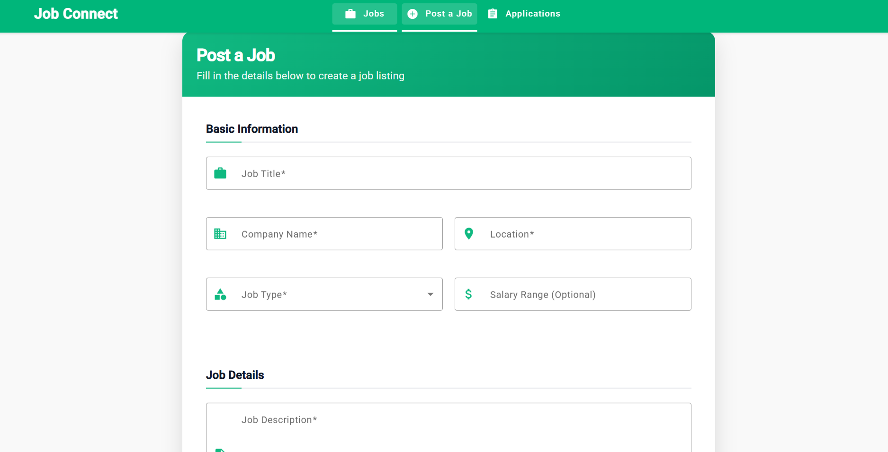
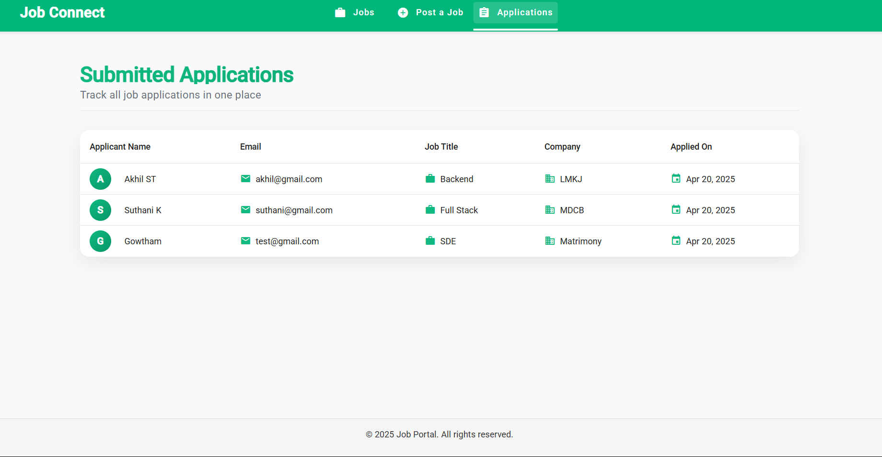
Post a job:
Applications submitted:

Slide 10
API Module
Job API Endpoints: Provides RESTful API endpoints to manage job listings, including creating, retrieving, updating, and deleting job posts.
Application API Endpoints: Allows job seekers to apply for jobs through dedicated endpoints, and enables employers to manage applications.
CRUD Operations: Supports all essential operations for job management (Create, Read, Update, Delete) and application submission.
Data Validation: Ensures all data passed through the API is validated (e.g., job fields, application form details).
Error Handling: Implements proper error handling and HTTP status codes to respond with meaningful messages (e.g., 400 for bad requests, 404 for not found).

Slide 11
Frontend Overview:
Angular Material: Used to design a responsive and modern UI with pre-built components like buttons, forms, and cards.
Key Components:
JobList, JobDetails, JobForm, ApplicationForm, ApplicationsList
Routing:
/jobs, /jobs/:id, /jobs/new, /jobs/:id/apply

Slide 12
Backend Overview:
Node.js with TypeScript: Backend built using Node.js for non-blocking I/O and TypeScript for strong typing and maintainability.
Express Framework: Used to handle routing and middleware efficiently, making the API lightweight and scalable.
RESTful API Structure:
Job routes for Create, Read, Update, Delete (/api/jobs)
Application routes for applying and viewing applications (/api/jobs/:id/apply, /api/applications)
Database Connection:
MySQL is used to store job and application data.

Slide 13
THANK YOU

